Slide 1

WEB TECHNOLOGIES
Module 1:
CSS Flex properties and Media Queries
Dr.Sarasvathi V and Prof.Shruthi L
Department of Computer Science and Engineering.

Slide 2

WEB TECHNOLOGIES
CSS Properties-Flex and Media Queries
Dr.Sarasvathi V and Prof.Shruthi L
Department of Computer Science and Engineering

Slide 3
WEB TECHNOLOGIES
CSS PROPERTY
Flex Property
The flex property sets the flexible length on flexible items.
Using together with media queries to create a different layout for different screen sizes/devices
Syntax:
flex: flex-grow flex-shrink flex-basis|auto|initial|inherit;
The flex property can be specified with the help of 1, 2 or 3 values:
Eg:
One value :flex: auto
:flex: 1
Two Values: flex: 1 1
flex: 1 100px
Three values: flex: 1 1 100px
Keywords
auto-sets 1 and 1 to grow and shrink
initial-keyword is used to set a CSS property to its default value
inherit-keyword specifies that a property should inherit its value from its parent element
NOTE: If the element is not a flexible item, the flex-grow property has no effect.

Slide 4
WEB TECHNOLOGIES
FLEX PROPERTY
<html>
<head>
<style>
#main {
width: 300px;
height: 100px;
border: 1px solid #c3c3c3;
display: flex;
}
#main div {
flex-grow: 0;
flex-shrink: 0;
flex-basis: 50px;
}
#main div:nth-of-type(2) {
flex-basis: 100px;
}
</style>
</head>
Program to demonstrate flex-basis property
<body>
<h1>The flex-basis Property</h1>
<p>Set the initial length of the flex items to 50 pixels</p>
<p>Set the initial length of the second flex item to 100 pixels:</p>
<div id="main">
<div style="background-color:coral;">50px</div>
<div style="background-color:lightblue;">100px</div>
<div style="background-color:khaki;">50px</div>
<div style="background-color:pink;">50px</div>
<div style="background-color:lightgrey;">50px</div>
</div>
</body>
</html>
Selects the second element of div siblings

Slide 5
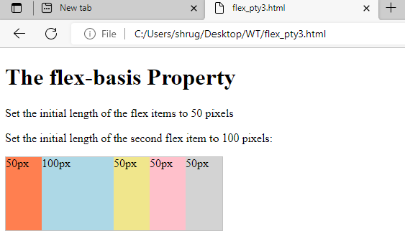
WEB TECHNOLOGIES
FLEX PROPERTY
flex-basis: The flex-basis property specifies the initial length of a flexible item.
Syntax
flex-basis: number|auto|initial|inherit;
Eg:
div:nth-of-type(2)
{
flex-basis:100px; }
Set the initial length of the second flex-item to 100 pixels

Slide 6
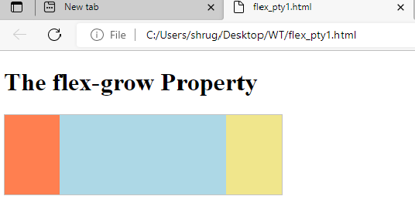
WEB TECHNOLOGIES
FLEX PROPERTY
flex-grow: The flex-grow property specifies how much the item will grow relative to the rest of the flexible items inside the same container.
Syntax
flex-grow: number|initial|inherit;
Eg:
div:nth-of-type(1){flex-grow:1;} div:nth-of-type(2) {flex-grow: 3;}
Here, the second flex-item grow three times wider than the first.
NOTE:Changes are mode in the style tag of head section.

Slide 7
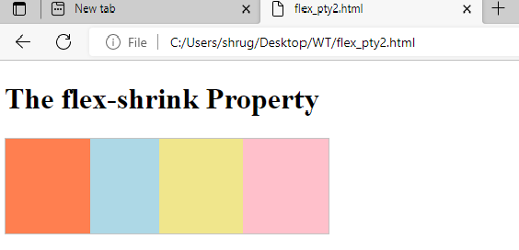
WEB TECHNOLOGIES
FLEX PROPERTY
flex-shrink: The flex-shrink property specifies how the item will shrink relative to the rest of the flexible items inside the same container.
Syntax
flex-shrink: number|initial|inherit;
Eg:
div:nth-of-type(2){ flex-shrink:3; }
Here, the second flex-item shrink three times more than the rest

Slide 8
WEB TECHNOLOGIES
MEDIA QUERY
CSS3 Introduced Media Queries
Media query is a CSS technique introduced in CSS3.
It uses the @media rule to include a block of CSS properties only if a certain condition is true.
Instead of looking for a type of device, they look at the capability of the device.
Media queries can be used to check many things, such as:
width and height of the viewport
width and height of the device
orientation (is the tablet/phone in landscape or portrait mode?)
resolution

Slide 9
WEB TECHNOLOGIES
MEDIA QUERY
CSS @media Rule
You can also use media queries to specify that certain styles are only for printed documents or for screen.
Another common use of media queries, is to hide elements on different screen sizes, to change the font size of an element on different screen sizes, change layout of a page depending on the orientation of the browser.
Syntax:
@media not|only mediatype and (expressions) {
CSS-Code;
}

Slide 10
WEB TECHNOLOGIES
MEDIA QUERY
One way to use media queries is to have an alternate CSS section right inside your style sheet.
You can also have different stylesheets for different media:
<link rel="stylesheet" media="mediatype and|not|only (expressions)" href="print.css">
When a media query is true, the corresponding style sheet or style rules are applied, following the normal cascading rules.
Unless you use the not or only operators, the media type is optional and the all type will be implied.

Slide 11
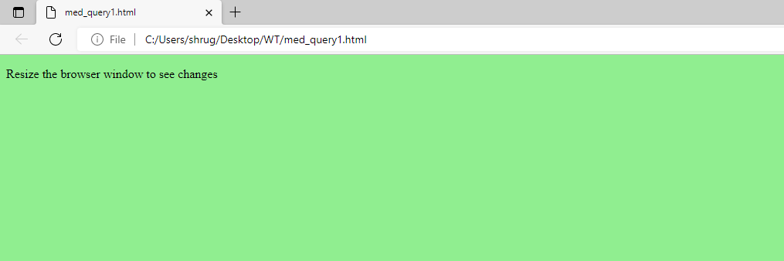
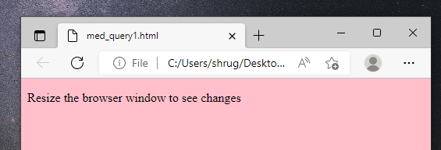
WEB TECHNOLOGIES
MEDIA QUERY
Program to demonstrate media query change in bgcolor
<!DOCTYPE html>
<html>
<head>
<style>
body {
background-color: lightgreen;
}
@media screen and (min-width: 480px) {
body {
background-color: pink;
}
}
</style>
</head>
<body>
<h1>Resize the browser window to see the effect!</h1>
</body>
</html>
The media query will only apply if the media type is screen and the viewport is 480px wide or wider

Slide 12
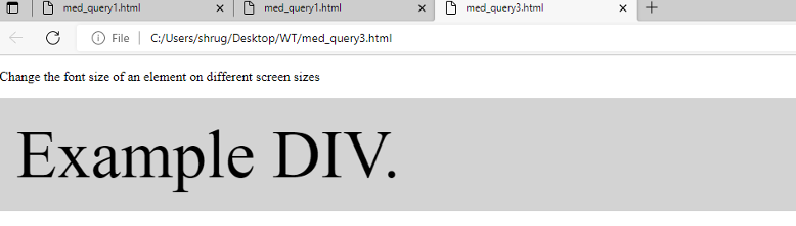
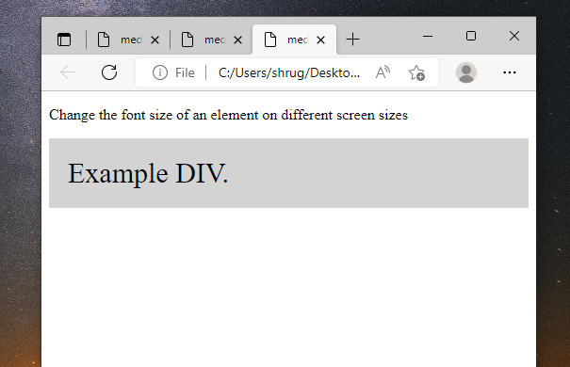
WEB TECHNOLOGIES
MEDIA QUERY
Program to demonstrate media query- change in font-size
<!DOCTYPE html>
<html>
<head>
<style>
div.example {
background-color: lightgrey;
padding: 20px;
}
@media screen and (min-width: 600px) {
div.example {
font-size: 80px;
}
}
@media screen and (max-width: 600px) {
div.example {
font-size: 30px;
}
}
</style>
</head>
<body>
<p>Change the font size of an element on different screen sizes</p>
<div class="example">Example DIV.</div>
</body>
</html>

Slide 13
THANK YOU
Dr.Sarasvathi V and Shruthi L
Department of Computer Science Engineering

